Slide 1
SWOT Analysis
Of Local Job in Software & IT Industry in Bangladesh

Slide 2
Introduction
01
A Basic Introduction of SWOT Analysis.
TABLE OF CONTENTS
Job Profiles of Our Team
02
Contains the job profiles based on Bangladeshi sectors.
SWOT Analysis of Our Team
03
Contains SWOT analysis of our team.
Action Plan of Our Team
04
Contains the action plan of our team .

Slide 3
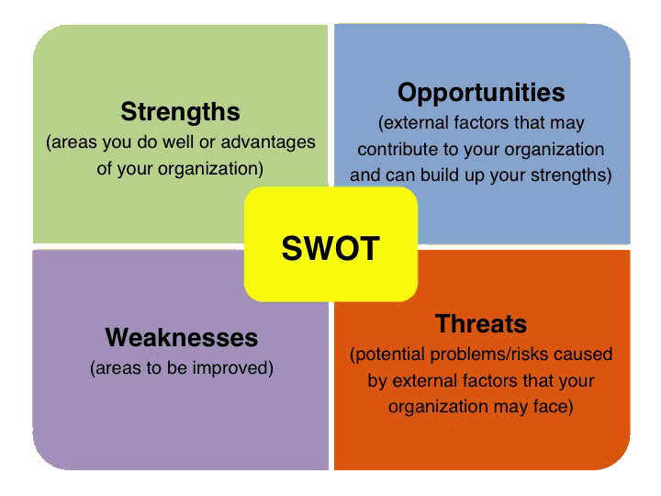
Introduction
SWOT stands for -
1. Strengths
2. Weaknesses
3. Opportunities
4. Threats
SWOT Analysis is a
technique for assessing
these four aspects of
your business.

Slide 4
Job Profile
Anup Hawlader ( 17101059)
Job Profile | Companies | Requirements
Graphic Designer | Freelancer.com Fiver.com Upwork.com | 1. Design knowledge of UI/UX 2. Knowledge of Scripting Language. 3. Knowledge of using UI Tools 4. Knowledge of Concept art 5. Uses of version control (behance) 6. Pre Knowledge of Adobe Tools
Job Profile | Companies | Requirements
Graphic Designer | Freelancer.com Fiver.com Upwork.com | 1. Design knowledge of UI/UX 2. Knowledge of Scripting Language. 3. Knowledge of using UI Tools 4. Knowledge of Concept art 5. Uses of version control (behance) 6. Pre Knowledge of Adobe Tools
SWOT Analysis
Strengths | Weakness | Opportunities | Threats
1. Good Knowledge of UI. 2. Good Knowledge of Adobe Tools. 3. Good Knowledge of Concept thinking. | 1. Making content with virtual content. 2. Illustration concept is not good. | 1. Ability to be a freelance Graphic Designer. | 1. Aboard competitions. 2. Tecnical Problems. 3. Client requirements satisfaction.
Action Plan
1. Increase knowledge on server side version control 2. Increase the knowledge of virtual content art and Illustration.

Slide 5
Job Profile
Fahmeda Akter ( 17101060)
Job Profile | Companies | Requirements
Quality Assurance | Enosis Solution Brain Station Datasoft limited Therap BD limited Gaze Technology Limited | 1. Design knowledge of testing tools 2. Knowledge of Java Language. 3. Knowledge of using extension test 4. Knowledge of MVC Architecture 5. Uses of version control (GIT/GITHUB) 6. Pre Knowledge of Mobile Application
SWOT Analysis
Strengths | Weakness | Opportunities | Threats
1. Good Knowledge of Bug fixing. 2. Good Knowledge of mobile applications. 3. Good Knowledge of SDLC. | 1. Implementation of Java Programming language. 2. Not good at extension management. | 1. Ability to be a front-desk minimizing tester. 2. Ability to be a unit tester. | 1. Huge competitions. 2. Tecnical Problems. 3. Client requirements satisfaction of testing based on web and mobile application.
Action Plan
1. Increase knowledge on Java Programming Language. 2. Increase the knowledge of quality and functional testing and uses of version control.

Slide 6
Job Profile
Farzana Lubna ( 17101064)
Job Profile | Companies | Requirements
Business Analyst | Grameen Phone Brain Station Datasoft limited Robi Gaze Technology Limited | 1. Oral & Written communication skills. 2. Interpersonal & consultative skills. 3. Analytical thinking skills. 4. Knowledge of MS tools. 5. Database Management skills (SQL).
SWOT Analysis
Strengths | Weakness | Opportunities | Threats
1. Good at communication skills. 2. Good at interpersonal skills. 3. Good at consultative skills. | 1. Database management. 2. Not aboard knowledge of using MS tools. 3. Analytical thinking is not so good. | 1. Ability to be a Colsultant of Business Analyst. 2. Ability to be fullfill Business Analyst. | 1. Huge competitions. 2. Requirements of business specification.
Action Plan
1. Increase knowledge on MS tools efficiently. 2. Increase the knowledge of analytical thinking.

Slide 7
Job Profile
Remon Hasan ( 17101086)
Job Profile | Companies | Requirements
Software Engineer | Enosis Solution Brain Station Datasoft limited Therap BD limited Gaze Technology Limited | 1. Design knowledge of UI (Front End). 2. Implementation Knowledge of specific language. 3. Knowledge of making API . 4. Knowledge of MVC Architecture 5. Uses of version control (GIT/GITHUB) 6. Pre Knowledge of SDLC.
SWOT Analysis
Strengths | Weakness | Opportunities | Threats
1. Good Knowledge of version control. 2. Good Knowledge of UI specification. 3. Good Knowledge of SDLC. 4. Good at Backend of a particular language. | 1. Implementation of various languages at a time. 2. Core design of Forn-End. | 1. Ability to be a software engineer. 2. Ability to be a full stack software developer. | 1. Huge competitions. 2. Tecnical Problems. 3. Client requirements satisfaction of development of software..
Action Plan
1. Increase knowledge on core Front End design. 2. Increase the knowledge of shifting of multiple languages.

Slide 8
Job Profile
Sabrina Yeasmin ( 18201902)
Job Profile | Companies | Requirements
Human Resource Manager | Enosis Solution Brain Station Datasoft limited Therap BD limited Grameen Phone | 1. Management Skills 2. Operational Skills. 3. Knowledge of using MS Tools. 4. Communication skills.
SWOT Analysis
Strengths | Weakness | Opportunities | Threats
1. Good Knowledge of MS Tools. 2. Good at communication skills. | 1. Not good at Operational Skills. 2. Not good at Management Skills. | 1. Ability to be a Human Resourve Manager. | 1. Huge competitions. 2. Requirements Process individuals.
Action Plan
1. Increase the knowledge of Operational Skills. 2. Increase the knowledge of management skills.

Slide 9
ANY Question?
Thank YOU *_*

